Slide 1
Engaging Millennial Learners with Technology
Tara Brandenburg
Devon Jancin
Colorado State University
Please go to Kahoot.it
on your phone or tablet
and enter the PIN#: 210259
http://memecreator.org/create

Slide 2
Interactive Tech: Kahoot.it
PIN#: 210259
You can:
create multiple choice quizzes (2-4 answers)
choose from large pre-made bank
share quizzes with other teachers
control how long answers are displayed
Benefits:
free
students don’t need to register
gives immediate feedback
is like a game-show
individual or partner
great for review

Slide 3
Literature Review: Kahoot Quiz
Lit Review Kahoot
In small groups, navigate to Kahoot.it on your smartphone, tablet, or laptop
Enter the PIN#: 210259
Create a username

Slide 4
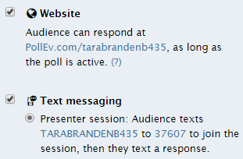
Interactive Tech: Poll Everywhere
http://www.polleverywhere.com/

Slide 5
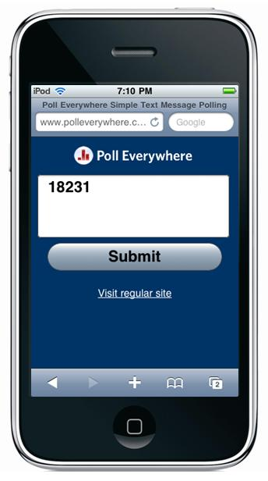
Interactive Tech: Poll Everywhere
http://www.polleverywhere.com/
Respond with website or text
Displays results in real time
Anonymous
Open ended, multiple choice, or clickable image
Scales of agreement or understanding
http://www.learningsolutionsmag.com/

Slide 6
Generate Websites: Weebly
www.weebly.com
You can:
create websites
create blogs
have students showcase work in an online portfolio
display resources for students
Benefits:
public or private
intuitive and easy to use
free

Slide 7
Selfie Videos Link to Bader’s video
Benefits:
easy & efficient way to get speaking sample
most Ss already know how to make them
helps teacher give individual pronunciation feedback
You can:
have Ss record themselves with their Smart Phone or iPad
use in Listening/Speaking, Grammar
in place of presentations, interviews
use in self, peer reflection

Slide 8
Video Games for Social Change
http://ncase.me/polygons/
You can:
use to generate class discussion
use for essay writing prompts
use to explain U.S. history
use to explain social issues (bias, racism, homelessness)
Benefits:
experiential learning increases understanding of complex situations
increases empathy
plagiarism less likely

Slide 9
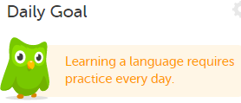
Language Games: Duo Lingo
https://www.duolingo.com/
Learn English from 22 languages
Soon to be 22 languages from English
Create free account to move through levels

Slide 10
Student Friendly Corpus:
http://fraze.it/
Pop Media Examples
Filters for genre/context
Dictionary
Synonyms
Translate
Images
Youtube Videos
English, French, Spanish, German, Italian or Portuguese

Slide 11
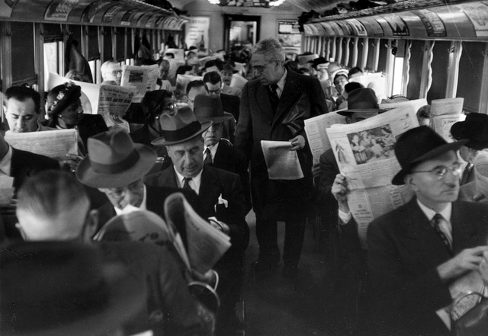
ESL Current News: Newsela
https://newsela.com/
Recent news
5 graded levels
Browse or search
Use online or print
Track students’ reading
http://thefuturebuzz.com/

Slide 12
Word Clouds
www.wordle.net
Find key words
Summaries
Reading previews
www.wordle.net

Slide 13
Viral media in the classroom: Memes
Pair humorous images with class information
Students can generate memes for vocabulary practice
http://memecreator.org/create

Slide 14
And now, the moment you’ve been waiting for...
http://www.polleverywhere.com/
jenowenby.wordpress.com

Slide 15
References
Chan, E., & Kuhn, J. (2015). Proceedings from TESOL 2015: Using games to bridge students’ social responsibilities and language learning. Toronto, Canada: TESOL International Association.
Jonas-Dwyer, D. & Pospisil, R. (2004). The Millennial effect: Implications for academic development. Higher Education Research and Development Society of Australasia, 194-206.
McGlynn, A.P. (2005). Teaching millennials, our newest cultural cohort. Education Digest, 71(4), 12-26.
Rau, P.P, Gao, Q. & Wu, L. (2008). Using mobile communication technology in high school education: Motivation, pressure, and learning performance. Computers & Education, 50, 1–22.

